Slide 2
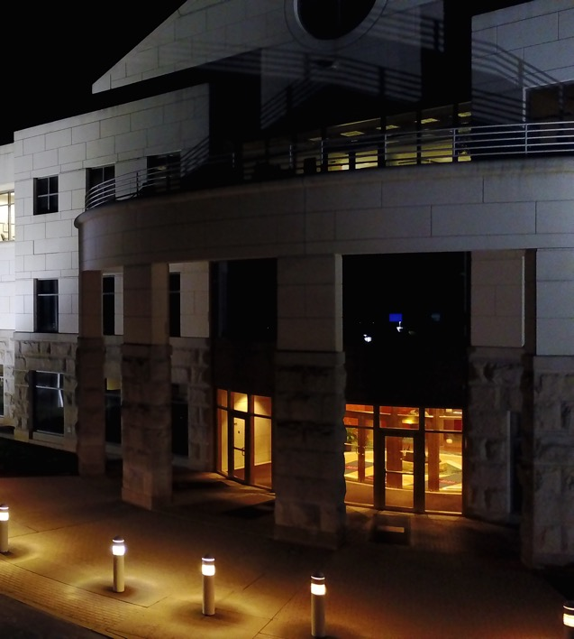
Company Overview
Founded in 2014, Bowerbird Energy is an Engineering, Procurement, and Construction (EPC) firm headquartered in Richmond, VA.
Our primary mission is to partner with C&I and government agencies to develop, maintain, and implement a comprehensive energy and environmental management plan.
Investments in energy efficiency and clean energy do not have to be complicated or expensive. Make energy services simple.

Slide 3
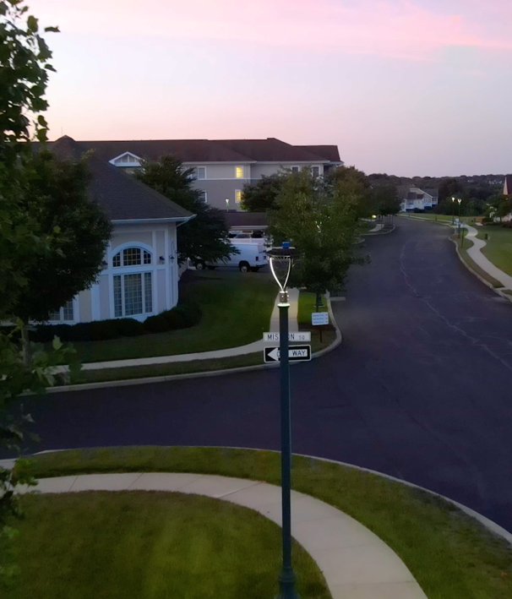
How We’re Different
The energy industry is constantly evolving – regulations, rebates/ tax incentives, and technology.
Let Bowerbird take the confusion out of it, streamline the approach, and maximize value for each of your new construction or O&M projects.

Slide 4
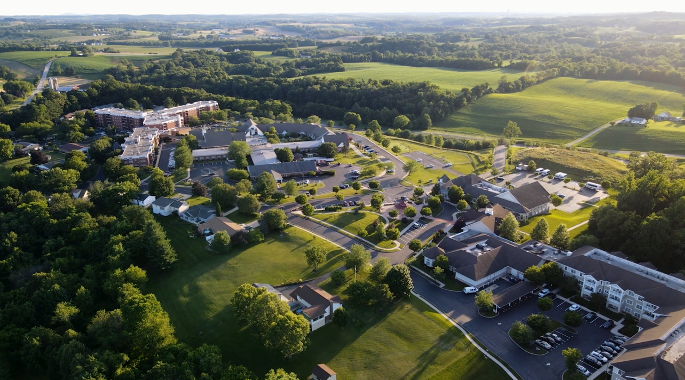
WHO TRUSTS US AND WHY?
Since 2014 real estate developers, construction firms, property managers, engineers, government agencies and more, have called on Bowerbird Energy to deliver energy conservation projects on time and within budget, that not only produce verifiable savings, but meet or exceed environmental goals.

Slide 5
Veteran-Owned and Operated Core Values
Integrity
Dedication
Innovation

Slide 6
Credentials
Class A Commercial Improvement Contractor (VA)
Master Electrical License (VA/MD)
Certified Energy Manager (AEE)
LEED Accredited (USGBC)
30HR Certified (OSHA)
NABCEP Certified (Solar)
Part 107 (sUAS Pilot) (FAA)

Slide 7
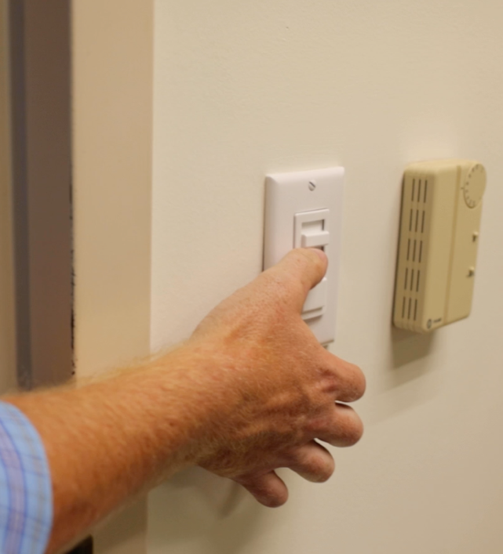
Products
Solar Panels and Collectors
LED Lighting and Controls
Germicidal UVC Lighting and Air Purification
IoT Technologies
Services
Construction Management
M.E.P Contracting
Energy Engineering
Wholesale Supplies
Performance Contracting

Slide 8
Headquartered in Richmond, VA , Since 2014
Warehouse – Richmond, VA
National Distribution, Regional Design/Build
Past Performance with the Federal Government and Fortune 500
Certified SDVOSB / Micro-SWAM 716129

Slide 9
Some Partner Clients…
NATO Allied Command Transformation
U.S Air Force
Colliers International
Dominion Energy
The Millwood School
Westminster Canterbury Retirement Community
Lutheran Social Ministries of Maryland
City of Hyattsville, MD
Silver Diner Restaurant Group

